Slide 1
Development of master curricula for natural disasters risk management in Western Balkan countries
NatRisk Project Web Site & Project Management Platform
Georgios E. Stavroulakis
Institute of Computational Mechanics and Optimization (www.comeco.tuc.gr)
School of Production Engineering and Management (www.dpem.tuc.gr)
Technical University of Crete, Greece
Established Practices and Programmes in Greece / 6/4/2017
Project number: 573806-EPP-1-2016-1-RS-EPPKA2-CBHE-JP
"This project has been funded with support from the European Commission. This publication reflects the views only of the author, and the Commission cannot be held responsible for any use which may be made of the information contained therein"

Slide 2
<number>
Development of master curricula for natural disasters risk management in Western Balkan countries
Topics
Natural Risks in Greece
With emphasis in earthquakes
Master programmes etc
With emphasis in TUC expertise

Slide 3
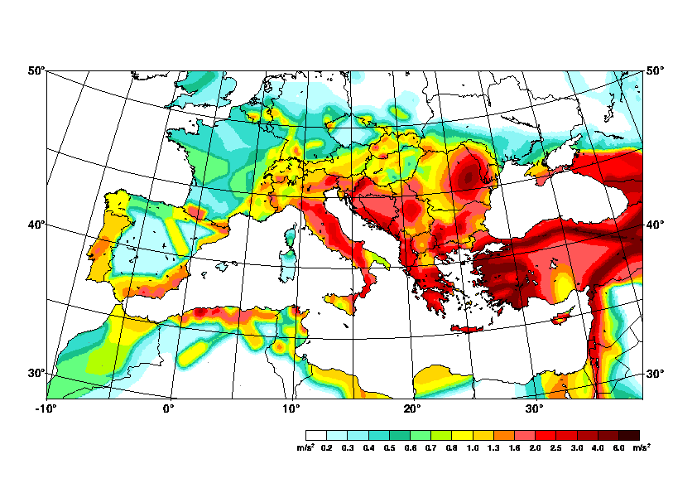
Development of master curricula for natural disasters risk management in Western Balkan countries
<number>
Earthquake activity

Slide 4
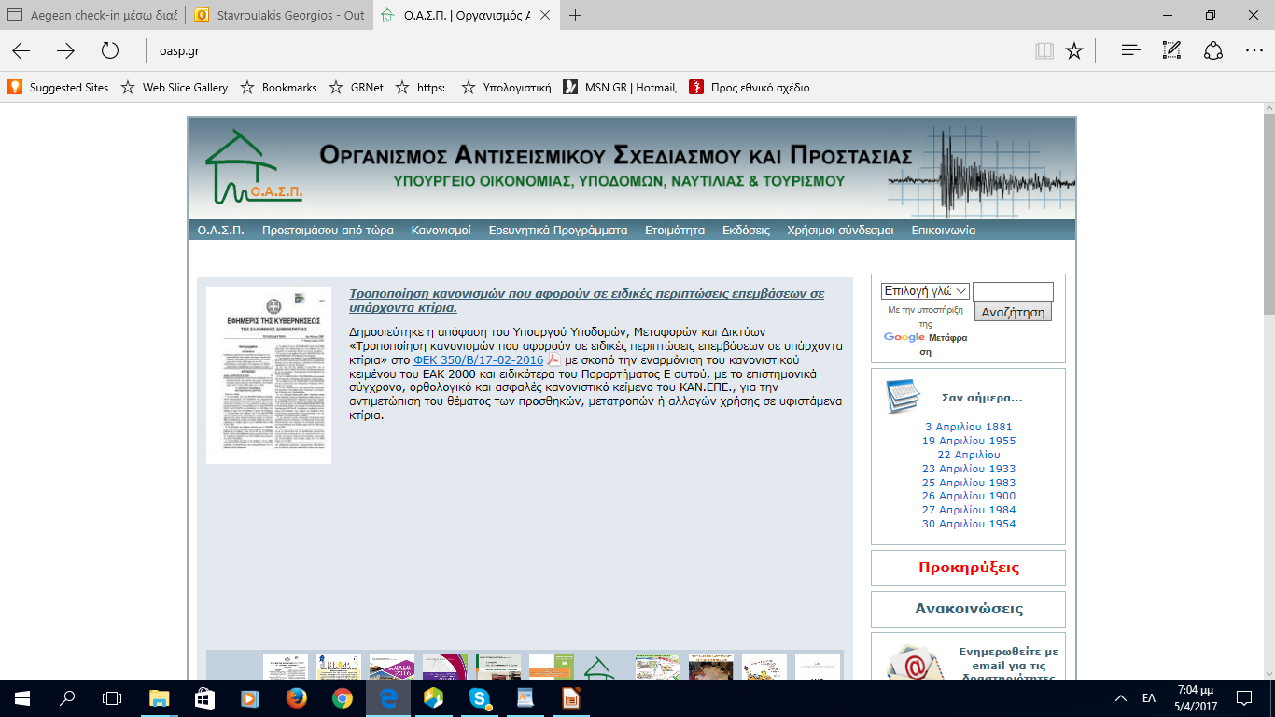
Development of master curricula for natural disasters risk management in Western Balkan countries
Aseismic Design and Protection Organization: regulations following the Euronorms

Slide 5
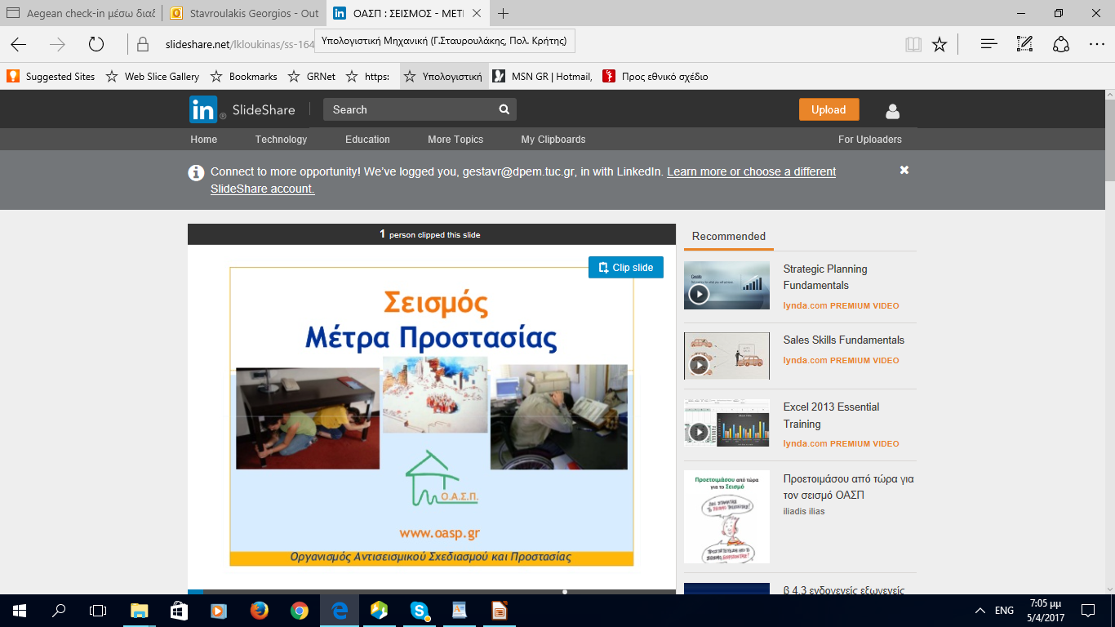
Development of master curricula for natural disasters risk management in Western Balkan countries
<number>
Aseismic Design and Protection Organization: Information of people how to behave during an earthquake

Slide 6
Development of master curricula for natural disasters risk management in Western Balkan countries
<number>
Building Information Management and Analysis (software, for instance www.pi.gr)

Slide 7
Development of master curricula for natural disasters risk management in Western Balkan countries
<number>
Building Information Management and Analysis (software, for instance www.pi.gr)

Slide 8
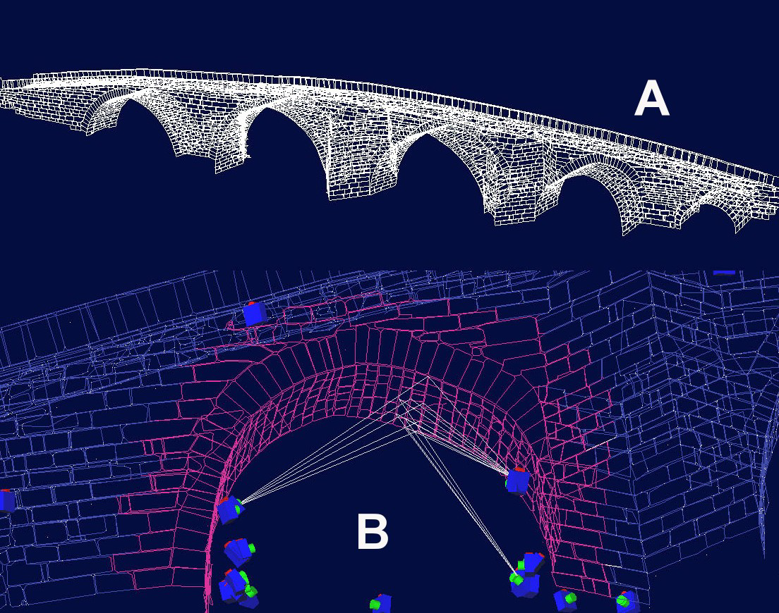
Development of master curricula for natural disasters risk management in Western Balkan countries
<number>
TUC expertise: photogrammetry, finite elements, analysis (Stavroulaki, Stavroulakis, Koutsianitis, Riveiro, Drosopoulos, Conde)

Slide 9
Development of master curricula for natural disasters risk management in Western Balkan countries
<number>
TUC expertise: optimization

Slide 10
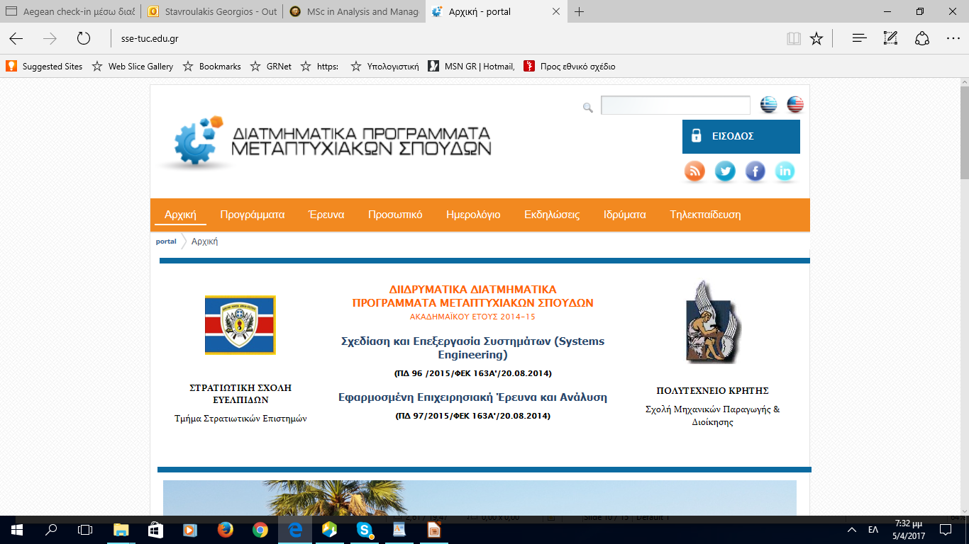
Development of master curricula for natural disasters risk management in Western Balkan countries
<number>
MSC Systems Engineering and Applied Operational Research and Analysis TUC/Production Engineering and Management and Military Academy in Athens

Slide 11
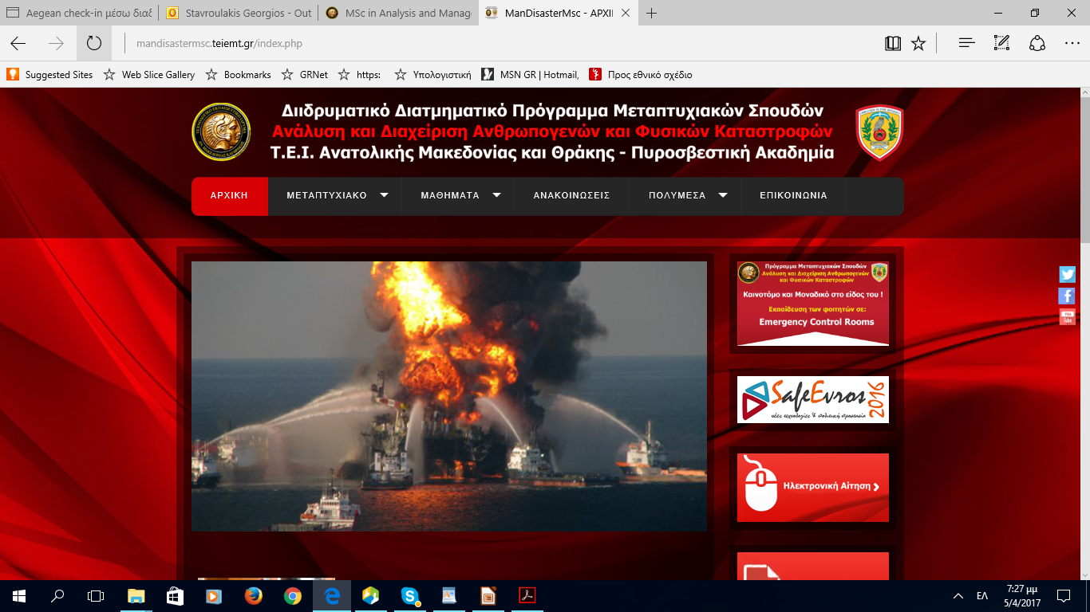
Development of master curricula for natural disasters risk management in Western Balkan countries
<number>
MSC in Analysis and Management of Manmade and Natural Disasters Techn. Educ. Inst. of Eastern Macedonia and Thrace and Fire Brigade Academy in Athens http://mandisastermsc.teiemt.gr/index.php

Slide 12
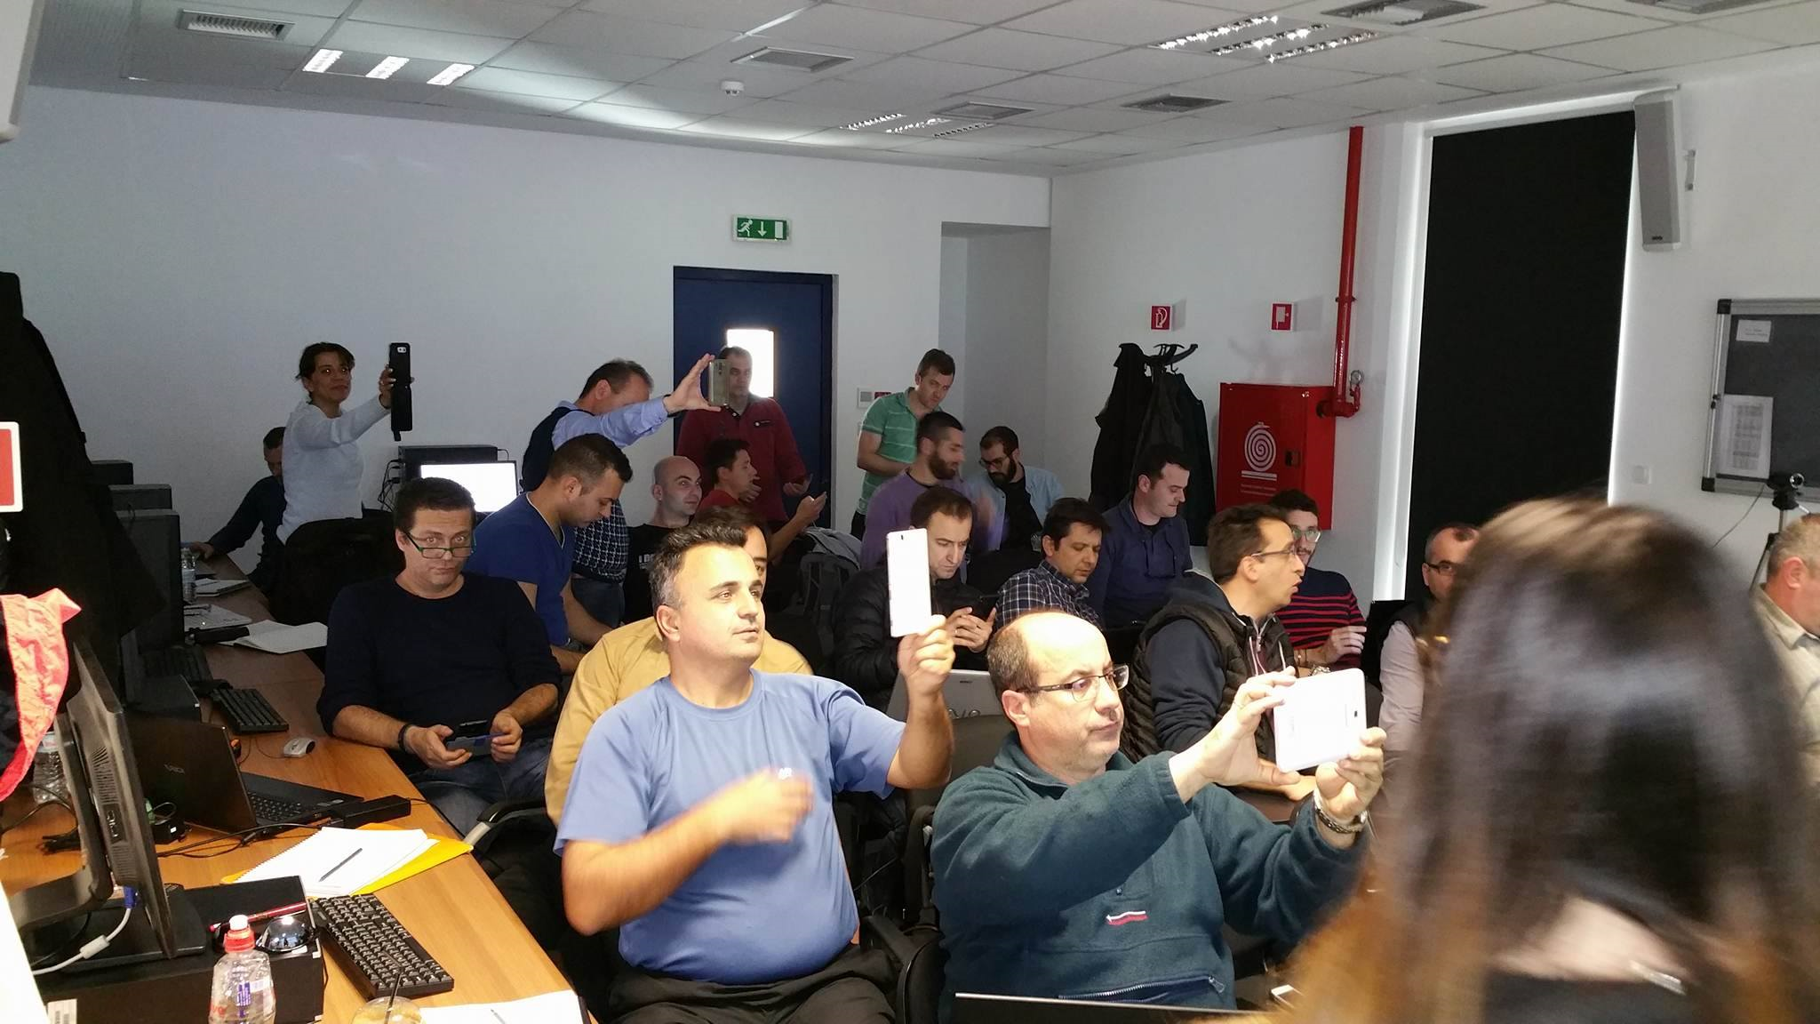
Development of master curricula for natural disasters risk management in Western Balkan countries
<number>
MSC in Analysis and Management of Manmade and Natural Disasters http://mandisastermsc.teiemt.gr/index.php

Slide 13
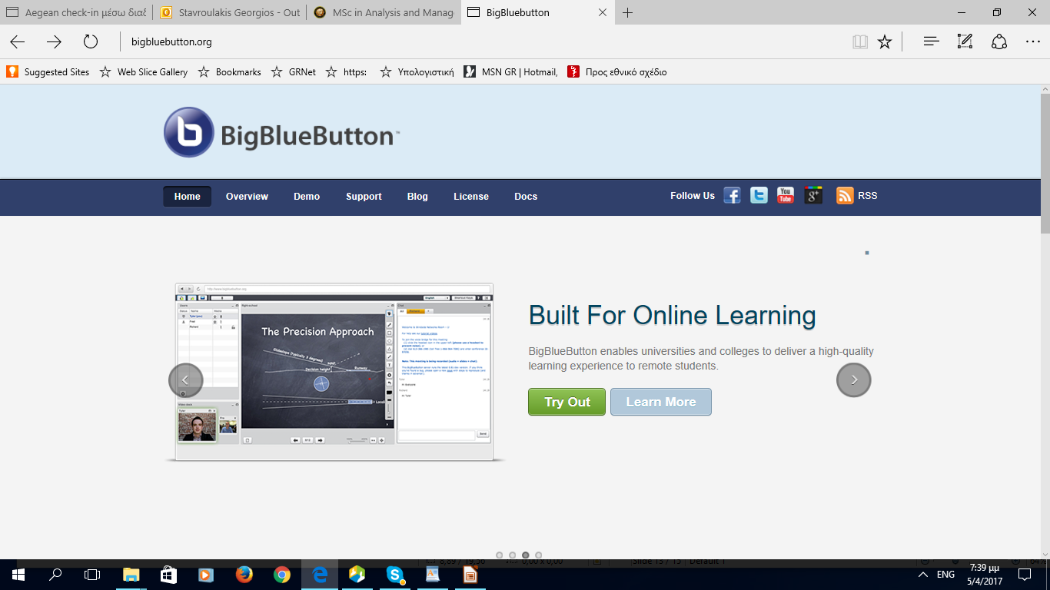
Development of master curricula for natural disasters risk management in Western Balkan countries
<number>
Distance learning: TUC is a reliable partner !!

Slide 14
Development of master curricula for natural disasters risk management in Western Balkan countries
Software solutions tested Big Blue Bottom (customized version) Moodle e-class (customized version) Viziq Finished educational programmes Offshore engineering (with Aristotle University and University of Patras, 3 rooms, ca. 15 students in each room) Actualization of knowledge, Production and Management Engineers (TUC, University of Crete, and University of Thrace, 5 groups, total of 150 students, most of them distance students – on line synchronous education, automatic exams through moodle) Distance learning: TUC is a reliable partner !!

Slide 15
Development of master curricula for natural disasters risk management in Western Balkan countries
Thanks for your attention!!!
<number>

